Slide 1
Class 4 2011W
All slides are included but we will discuss only selected slides.
Discussion of analysis and the tools will take several weeks to finish.
The first and most important step is the Preliminary Investigation and its’ associated report.

Slide 2
Term Test
The date of your Term Test (there is only 1) is Monday Feb 27 2012

Slide 3
What is Systems Analysis ?
Systems analysis – a problem-solving technique that decomposes a system into its component pieces for the purpose of studying how well those component parts work and interact to accomplish their purpose.
Systems design – a complementary problem-solving technique (to systems analysis) that reassembles a system’s component pieces back into a complete system—hopefully, an improved system. This may involves adding, deleting, and changing pieces relative to the original system.
Information systems analysis – those development phases in an information systems development project the primarily focus on the business problem and requirements, independent of any technology that can or will be used to implement a solution to that problem.

Slide 4
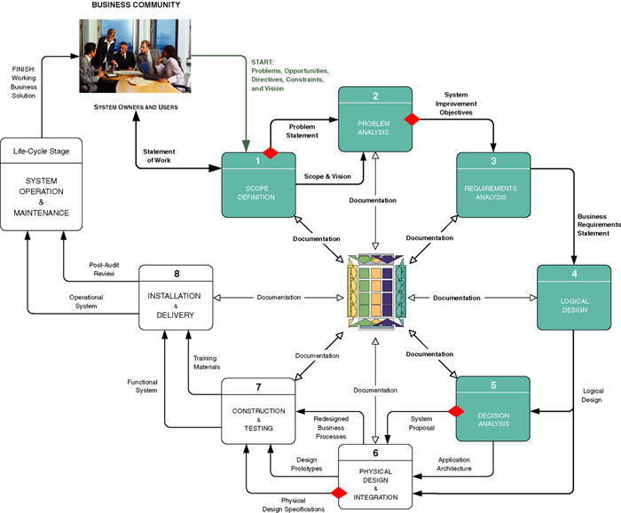
Context of Systems Analysis

Slide 5
Repository
Repository – a location (or set of locations) where systems analysts, systems designers, and system builders keep all of the documentation associated with one or more systems or projects.
Network directory of computer-generated files that contain project correspondence, reports, and data
CASE tool dictionary or encyclopedia (Chapter 3)
Printed documentation (binders and system libraries)
Intranet website interface to the above components

Slide 6
Model-Driven Analysis Methods
Model-driven analysis – a problem-solving approach that emphasizes the drawing of pictorial system models to document and validate both existing and/or proposed systems. Ultimately, the system model becomes the blueprint for designing and constructing an improved system.
Model – a representation of either reality or vision. Since “a picture is worth a thousand words,” most models use pictures to represent the reality or vision.

Slide 7
Model-Driven Approaches
Traditional Approaches
Structured Analysis
Focuses on the flow of data through processes
Key model: data flow diagram
Information Engineering
Focuses on structure of stored data
Key model: entity relationship diagram
Object-Oriented Approach
integrates data and process concerns into objects
Object – the encapsulation of the data (called properties) that describes a discrete person, object, place, event, or thing, with all the processes (called methods) that are allowed to use or update the data and properties. The only way to access or update the object’s data is to use the object’s predefined processes.
Unified Modeling Language (UML)

Slide 8
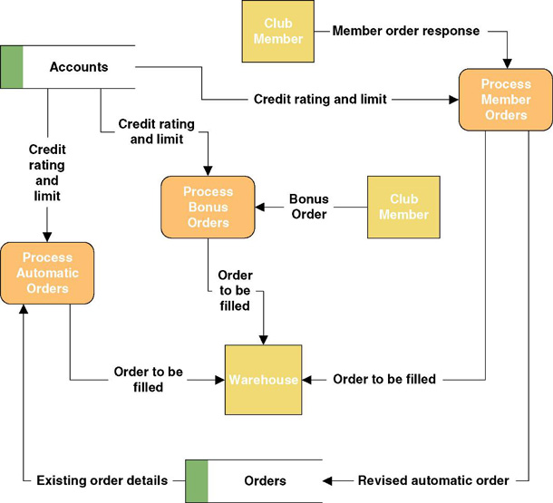
A Simple Process Model

Slide 9
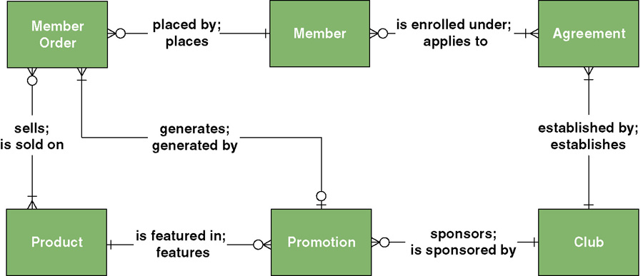
A Simple Data Model

Slide 10
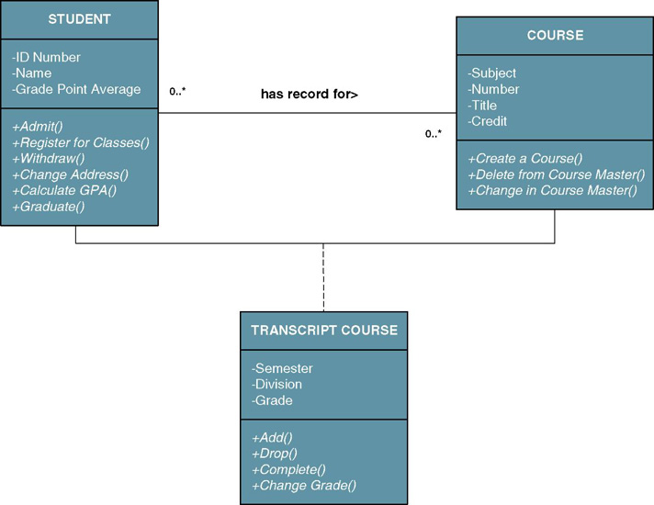
A Simple Object Model

Slide 11
Accelerated Systems Analysis
Accelerated systems analysis approaches emphasize the construction of prototypes to more rapidly identify business and user requirements for a new system.
prototype – a small-scale, incomplete, but working sample of a desired system.
Accelerated systems analysis approaches
Discovery Prototyping
Rapid Architected Analysis

Slide 12
Discovery Prototyping
Discovery prototyping – a technique used to identify the users’ business requirements by having them react to a quick-and-dirty implementation of those requirements.
Advantages
Prototypes cater to the “I’ll know what I want when I see it” way of thinking that is characteristic of many users and managers.
Disadvantages
Can become preoccupied with final “look and feel” prematurely
Can encourage a premature focus on, and commitment to, design
Users can be misled to believe that the completed system can be built rapidly using prototyping tools

Slide 13
Rapid Architected Analysis
Rapid architected analysis – an approach that attempts to derive system models (as described earlier in this section) from existing systems or discovery prototypes.
Reverse engineering – the use of technology that reads the program code for an existing database, application program, and/or user interface and automatically generates the equivalent system model.

Slide 14
Requirements Discovery
Requirements discovery – the process, used by systems analysts of identifying or extracting system problems and solution requirements from the user community.

Slide 15
Requirements Discovery Methods
Fact-finding – the process of collecting information about system problems, opportunities, solution requirements, and priorities.
Sampling existing documentation, reports, forms, databases, etc
Research of relevant literature
Observation of the current system
Questionnaires and surveys
Interviews
Joint requirements planning (JRP) –use of facilitated workshops to bring together all of the system owners, users, and analysts, and some systems designer and builders to jointly perform systems analysis.
Considered a part of a larger method called joint application development (JAD), a more comprehensive application of the JRP techniques to the entire systems development process.

Slide 16
Business Process Redesign
Business process redesign (BPR) – the application of systems analysis methods to the goal of dramatically changing and improving the fundamental business processes of an organization, independent of information technology.

Slide 17
Agile Methods
Agile method – integration of various approaches of systems analysis and design for applications as deemed appropriate to problem being solved and the system being developed.
Most commercial methodologies do not impose a single approach (structured analysis, IE, OOA) on systems analysts.
Instead, they integrate all popular approaches into a collection of agile methods.
System developers are given the flexibility to select from a variety of tools and techniques to best accomplish the tasks at hand,
Hypothetical FAST methodology operates this way.

Slide 18
FAST Systems Analysis Phases
Scope Definition Phase
Is the project worth looking at?
Problem Analysis Phase
Is a new system worth building?
Requirements Analysis Phase
What do the users need and want from the new system?
Logical Design Phase
What must the new system do?
Decision Analysis Phase
What is the best solution?

Slide 19
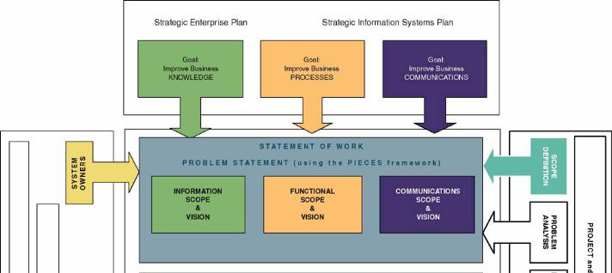
Context of Scope Definition Phase

Slide 20
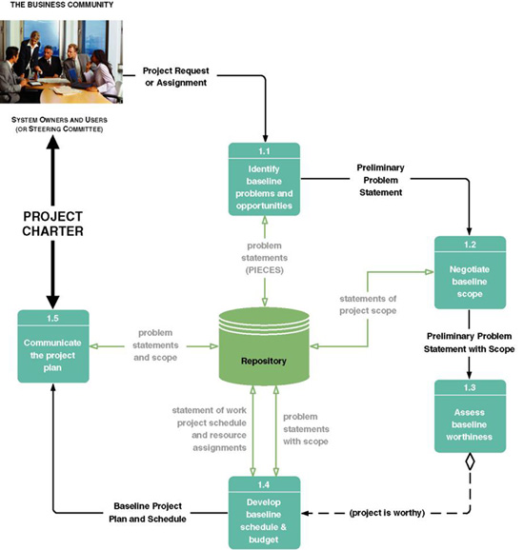
Tasks for the Scope Definition Phase

Slide 21
Key Terms for Scope Definition Phase
Steering body – a committee of executive business and system managers that studies and prioritizes competing project proposals to determine which projects will return the most value to the organization and thus should be approved for continues systems development.
Also called a steering committee.
Project charter – the final deliverable for the preliminary investigation phase. A project charter defines the project scope, plan, methodology, standards, and so on.
Preliminary master plan includes preliminary schedule and resource assignments (also called a baseline plan).
Detailed plan and schedule for completing the next phase of the project.

Slide 22
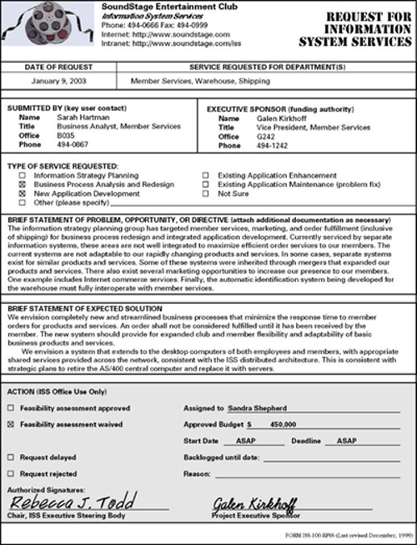
Sample Request for System Services

Slide 23
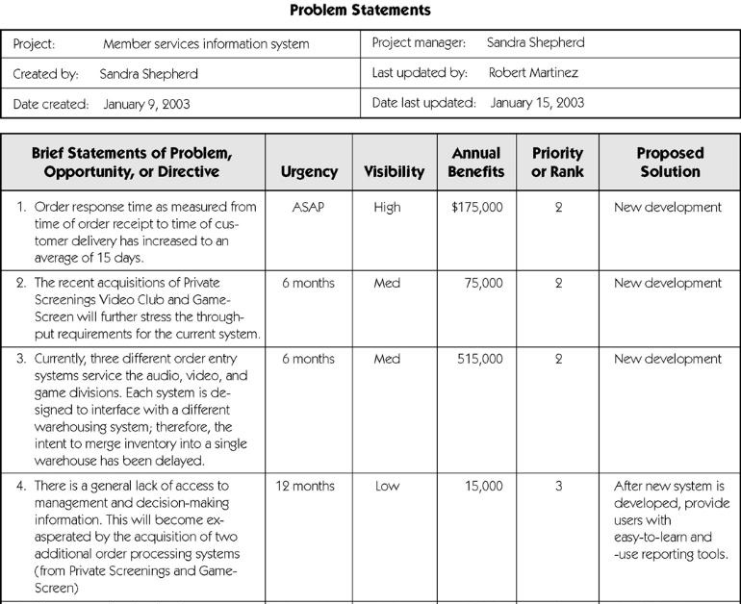
Sample Problem Statements

Slide 24
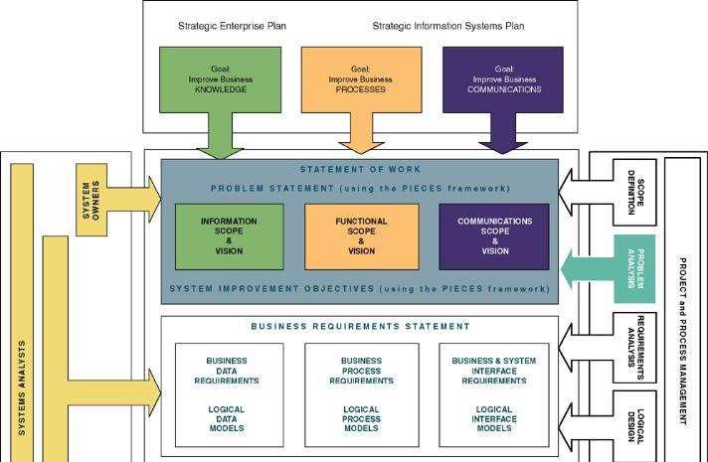
Context of Problem Analysis Phase

Slide 25
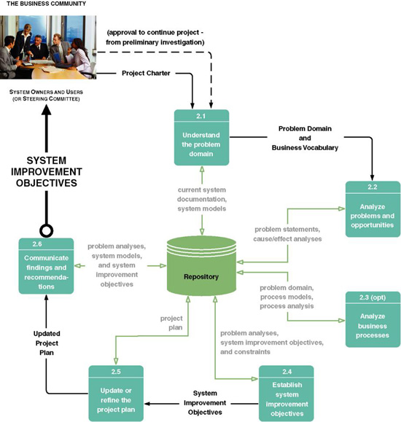
Tasks of the Problem Analysis Phase

Slide 26
Key Terms of the Problem Analysis Phase
Cause-and-effect analysis – a technique in which problems are studied to determine their causes and effects.
In practice, effects can be symptomatic of more deeply rooted problems which, in turn, must be analyzed for causes and effects until the causes and effects do not yield symptoms of other problems.
Context Diagram – a pictorial model that shows how the system interacts with the world around it and specifies in general terms the system inputs and outputs.

Slide 27
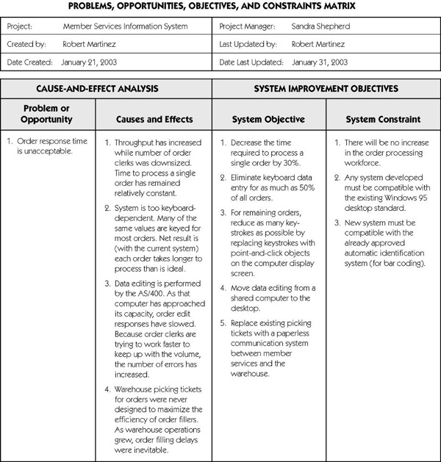
Sample Cause-and-Effect Analysis

Slide 28
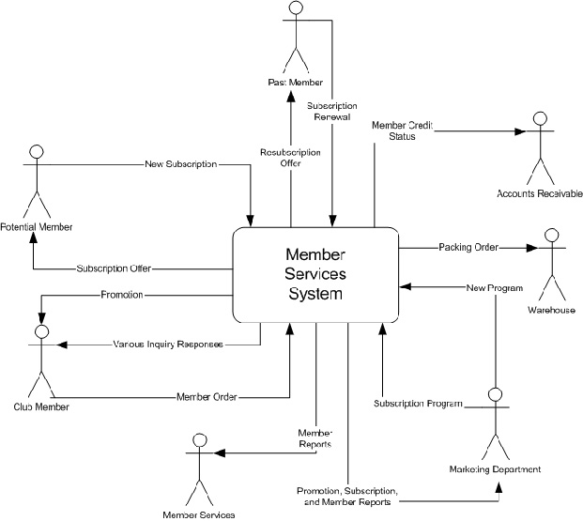
Sample Context Diagram

Slide 29
Key Terms of the Problem Analysis Phase (cont.)
Objective – a measure of success. It is something that you expect to achieve, if given sufficient resources.
Reduce the number of uncollectible customer accounts by 50 percent within the next year.
Increase by 25 percent the number of loan applications that can be processed during an eight-hour shift.
Decrease by 50 percent the time required to reschedule a production lot when a workstation malfunctions.
Constraint – something that will limit your flexibility in defining a solution to your objectives. Essentially, constraints cannot be changed.
The new system must be operational by April 15.
The new system cannot cost more than $350,000.
The new system must be web-enabled.
The new system must bill customers every 15 days.

Slide 30
System Improvement Report Outline
Executive summary (approximately 2 pages)
Summary of recommendation
Summary of problems, opportunities, and directives
Brief statement of system improvement objectives
Brief explanation of report contents
Background information (approximately 2 pages)
List of interviews and facilitated group meetings conducted
List of other sources of information that were exploited
Description of analytical techniques used
Overview of current system (approximately 5 pages)
Strategic implications (if project is part of or impacts existing IS strategic plan)
Models of the current system
Interface model (showing project scope)
Data model (showing project scope)
Geographical models (showing project scope)
Process model (showing functional decomposition only)

Slide 31
System Improvement Report Outline (cont.)
Analysis of the current system (approx. 5-10 pages)
Performance problems, opportunities, cause-effect analysis
Information problems, opportunities, cause-effect analysis
Economic problems, opportunities, cause-effect analysis
Control problems, opportunities, cause-effect analysis
Efficiency problems, opportunities, cause-effect analysis
Service problems, opportunities, and cause-effect analysis
Detailed recommendations (approx. 5-10 pages)
System improvement objectives and priorities
Constraints
Project Plan
Scope reassessment and refinement
Revised master plan
Detailed plan for the definition phase
Appendixes
Any detailed system models
Other documents as appropriate

Slide 32
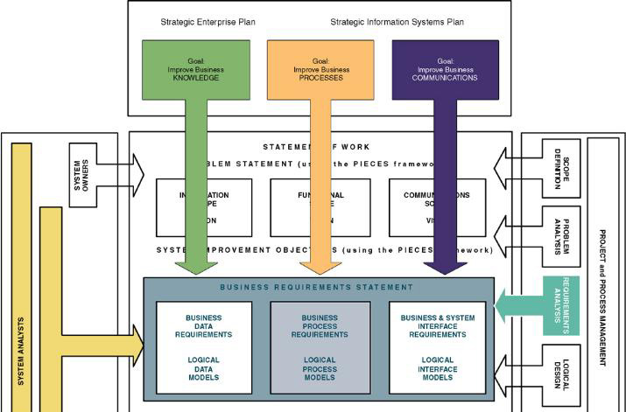
Context of Requirements Analysis Phase

Slide 33
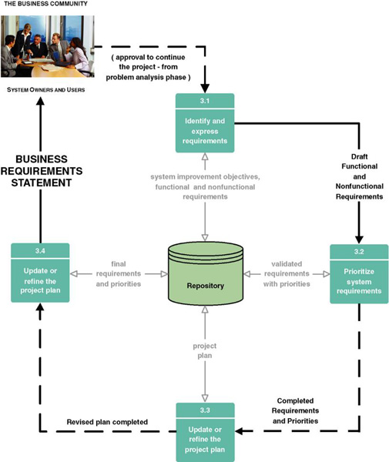
Requirements Analysis Phase Tasks

Slide 34
Key Terms of Requirements Analysis Phase
Functional requirement – a description of activities and services a system must provide.
inputs, outputs, processes, stored data
Nonfunctional requirement – a description of other features, characteristics, and constraints that define a satisfactory system.
Performance, ease of learning and use, budgets, deadlines, documentation, security, internal auditing controls

Slide 35
Key Terms of Requirements Analysis Phase (cont.)
Use case – a business scenario or event for which the system must provide a defined response. Use cases evolved out of object-oriented analysis; however, their use has become common in many other methodologies for systems analysis and design.

Slide 36
Key Terms of Requirements Analysis Phase (cont.)
Timeboxing – a technique that delivers information systems functionality and requirements through versioning.
The development team selects the smallest subset of the system that, if fully implemented, will return immediate value to the systems owners and users.
That subset is developed, ideally with a time frame of six to nine months or less.
Subsequently, value-added versions of the system are developed in similar time frames.
A mandatory requirement is one that must be fulfilled by the minimal system, version 1.0
A desirable requirement is one that is not absolutely essential to version 1.0. It may be essential to the vision of a future version.

Slide 37
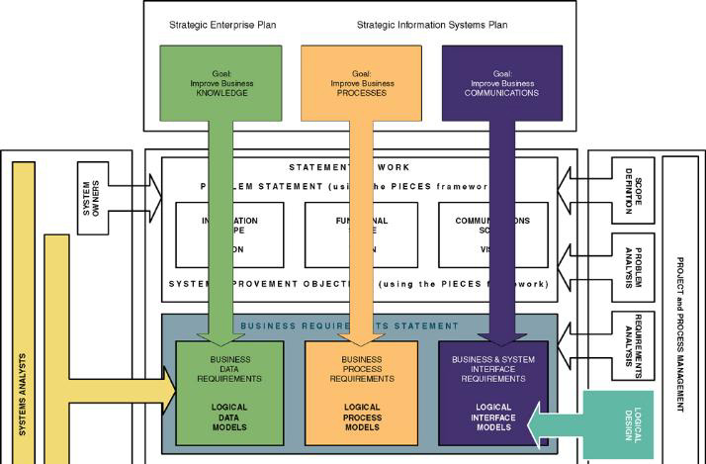
Context of Logical Design Phase of Systems Analysis

Slide 38
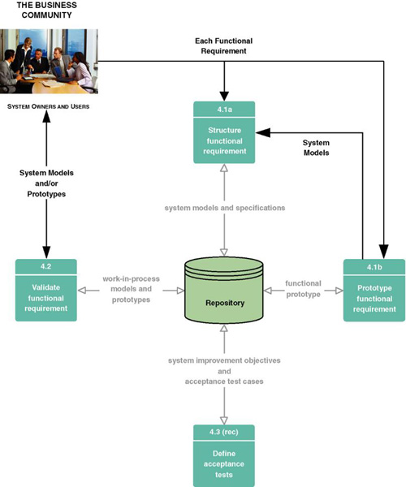
Tasks for Logical Design Phase

Slide 39
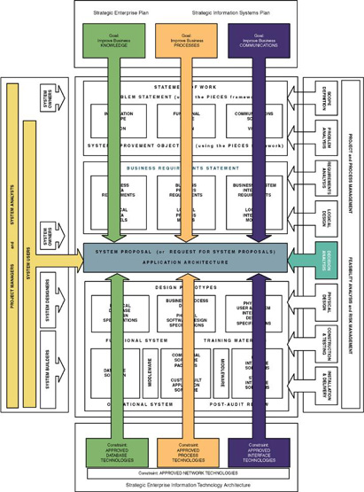
Context of Decision Analysis Phase

Slide 40
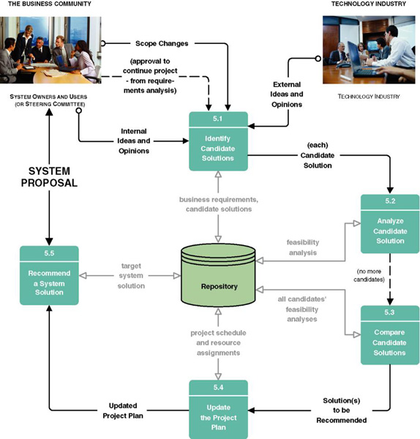
Tasks for Decision Analysis Phase

Slide 41
Key Terms of Decision Analysis Phase
Technical feasibility – Is the solution technically practical? Does our staff have the technical expertise to design and build this solution?
Operational feasibility – Will the solution fulfill the users’ requirements? To what degree? How will the solution change the users’ work environment? How do users feel about such a solution?
Economic feasibility – Is the solution cost-effective?
Schedule feasibility – Can the solution be designed and implemented within an acceptable time period?

Slide 42
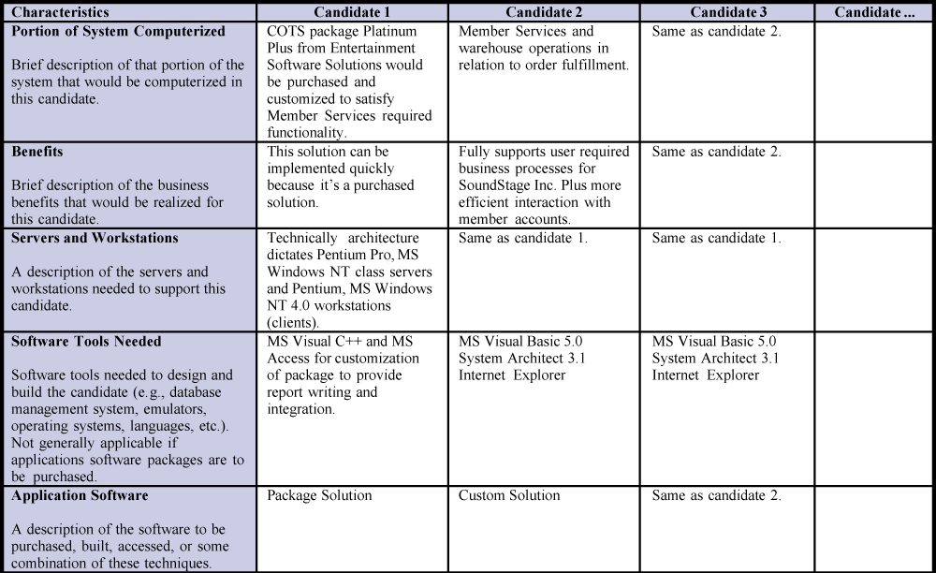
Candidate Systems Matrix

Slide 43
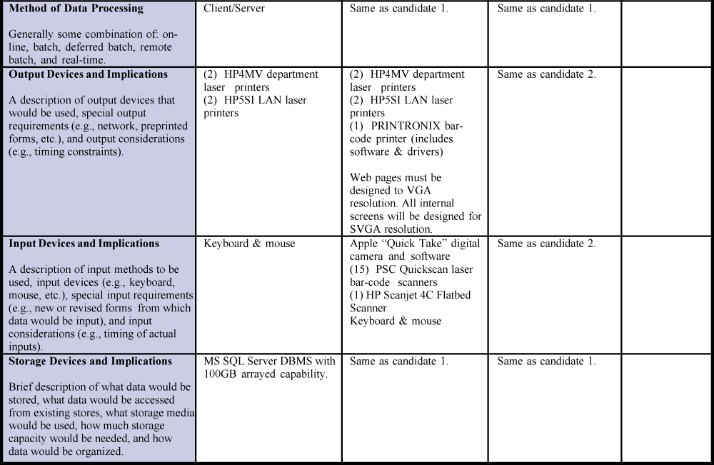
Candidate Systems Matrix (cont.)

Slide 44
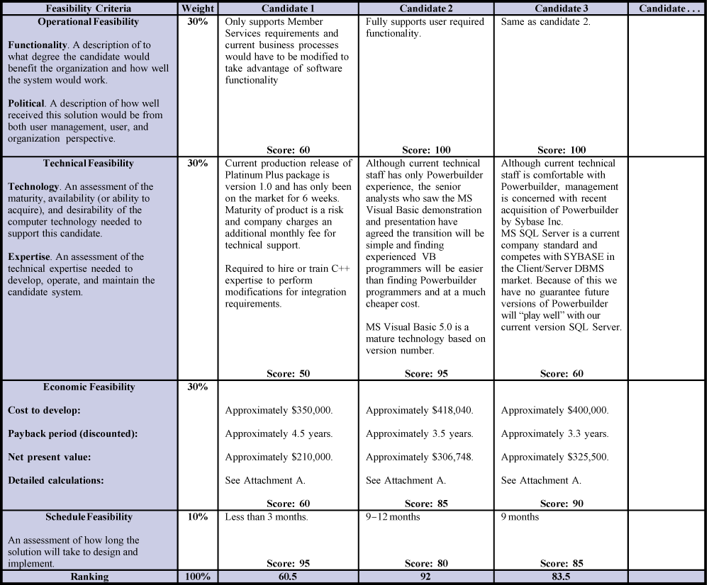
Feasibility Matrix

Slide 45
Typical System Proposal Outline
Introduction
Purpose of the report
Background of the project leading to this report
Scope of the report
Structure of the report
Tools and techniques used
Solution generated
Feasibility analysis (cost-benefit)
Information systems requirements
Alternative solutions and feasibility analysis
Recommendations
Appendices

